Slide 1
Advancing Social Mobility in Africa Through Entrepreneurialism in Higher Education
Bola A. Ibrahim
Graduate School of Education
The American University in Cairo

Slide 2
Higher Education and Social Mobility
“The world cannot be transformed without education,”
“It is through education that the daughter of a peasant can become a doctor, that the son of a mineworker can become the head of a mine, that a child of farmworkers can become the president of a great nation”

Slide 3
Entrepreneurial University and Social Mobility
Evidence about this phenomenon is fragmented and disorganized.
Secondary data used to evaluate patterns of enrollments in higher education in Africa, the utilization of entrepreneurialism in universities in other regions, and the improvement in social development indicators in recent World Bank data.
The study describes the practical implications of entrepreneurial activities in universities and the contribution of these to the social mobility in Africa.
The study introduces a framework for action that highlight the correlation between going entrepreneurial and advancing social mobility.

Slide 4
Research Questions:
How and to what extent can entrepreneurialism in universities help advance social mobility?
What are the key challenges that hinder universities in Africa from going entrepreneurial?

Slide 5
Data Sources
Three existing data sets were be linked to answer the research questions:
Major World Bank publications between 2015 – 2019 on Education and Social Development in Africa, including the Wrold Development Indicators.
Social Mobility Index for the American Higher data of the past five years, with focus on low ranking universities .
Entrepreneurial universities experiences in a European Region (UK, Spain).

Slide 6
World Development Indicators (WDI)
The World Development Indicators is a compilation of relevant, high-quality, and internationally comparable statistics about global development and the fight against poverty. The database contains 1,600 time series indicators for 217 economies and more than 40 country groups, with data for many indicators going back more than 50 years.

Slide 7
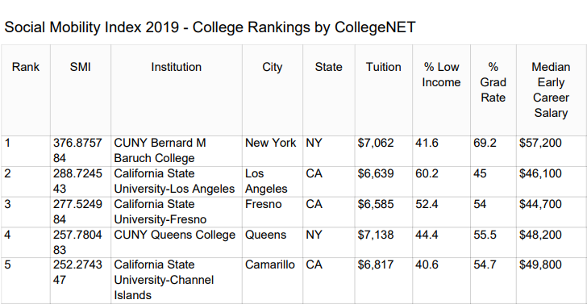
The Social Mobility Index (SMI)
It measures the extent to which a college or university educates more economically disadvantaged students (with family incomes below the national median) at lower tuition and the M of early career salaries

Slide 8
Entrepreneurship and Universities
Entrepreneurship has been considered as a key driver to economic growth, employment, and innovation
An entrepreneurial society generates scenarios in which its members can identify and exploit economic opportunities and knowledge that have not been previously visualized

Slide 9
Entrepreneurship and Universities
Universities are important catalysts for regional economic and social development because they are natural incubators that create new ideas and technologies, promote new business creation, and offer a variety of resources and capabilities that contribute to creating a sustained competitive advantage.

Slide 10
How is Africa doing in Education and Social Development?

Slide 11
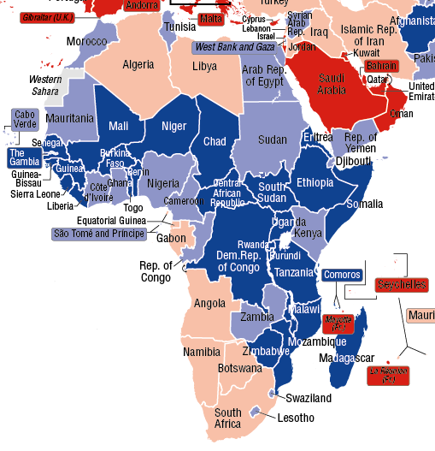
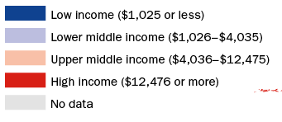
Africa by income
World Bank Data (FY 2017)

Slide 12
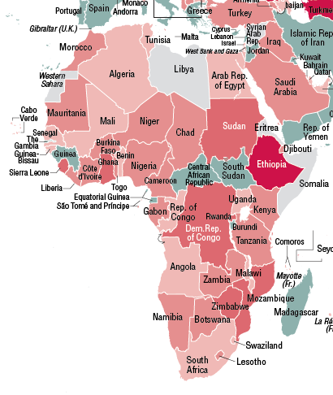
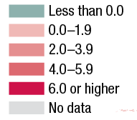
Economic Growth
Average annual growth in % GDP per capita 2009 – 2015 (World Bank Data)
GDP growth % slowed from 5 percent over 2000–2009 (the pre-crisis period) to 3.8 percent over 2009–15 (the post-crisis period)

Slide 13
Higher Education in Africa
In 2017, World Bank highlighted the rising demand and supply of tertiary education, along with disparities in access and economic payoffs across income groups.
Sub-Saharan Africa saw the fastest growth in its tertiary gross enrollment ratio (GER) during 1970-2013 at 4.3 percent annually, faster than the global average of 2.8 percent.
Even with this growth, sub-Saharan Africa has the lowest tertiary gross enrollment ratio globally, significantly lower than South Asia,

Slide 15
Higher Education in Africa
The study finds that the capacity of public universities in Africa has been insufficient to match the rising demand driven by;
Improved access to primary and secondary education,
A growing young population, and employment shifting away from the agriculture to manufacturing and services.
The rising demand for tertiary education has helped support rapid growth in the number private educational institutions.

Slide 16
Share of tertiary enrollment in private institution in parts of Africa

Slide 17
Who gets college education in Africa?
The poor do not get into college.. Why?
Because those students are often the first in their family to go to college, and may be already living below the poverty line, have needs that colleges must address so they can manage the financial, psychological, emotional, and social demands of higher education and professional life.
Analyzing enrollment data at the regional level across in Africa, the study finds that across regions, South and Central African countries perform worst in enrolling students from the poorest and middle classes populations – see next data chart

Slide 18
Tertiary education GER by wealth quintiles, by sub-Saharan African region (World Bank, 2017)

Slide 19
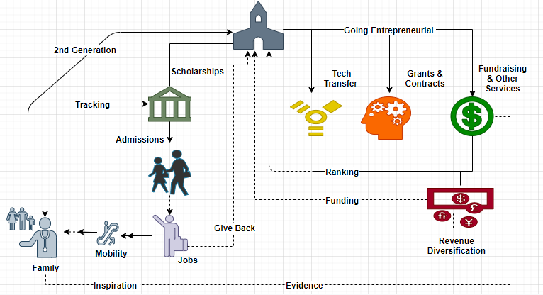
The Entrepreneurial University

Slide 20
The view from the other side
High tuition and fees at four-year public and private colleges increasingly discourage disadvantaged youths from pursuing college.
The immediate costs appear more real and oppressive than the improved career trajectories and higher earnings that college-going confers; gains are realized only in the future.
Students and parents may exaggerate the obstacles to pursuing further schooling.
The difficulty in piercing the complex system of financial and other assistance designed to support enrollment.

Slide 21
Why Higher Education Matter?
We can’t not truly begin to reduce inequality unless more students fulfil their aspirations and progress on into their chosen careers.
Rigorous, comprehensive, and well-designed higher education benefits everyone, rich and poor, and better educated citizens drive the economy and enrich our culture.
In a merit-based system, postsecondary schooling is a filter that keeps parents’ economic position from simply passing straight through to their children, thus promoting social mobility.

Slide 22
Highlights from the study:
•
•
Challenges remain for the promotion of academic entrepreneurship in Africa
•
Universities still navigate among distinct strategies to become entrepreneurial.
•
Research activity does not imply higher levels of academic entrepreneurship.
•
Academic entrepreneurship is also shaped by external elements to the university.
African countries have huge potential in academic entrepreneurship

Slide 23
The Legislative Reform
In the United States, this phenomenon has been occurring for 30 years since the enactment of the Bayh–Dole Act that is linked with the entrepreneurial and economic development activities of universities.
Egypt’s law no. 23 of 2018 on the provision of incentives to science, technology and innovation. The provisions of the law apply to all higher education institutions and scientific research bodies in Egypt.

Slide 24
Conclusion
Universities Can Fulfil Their Potential To Become Vehicles For Social Mobility, Driving Economic Growth And Sustainable Development
Universities Have A Vital Role To Play In A Knowledge-based Economy.
Universities Create Knowledge, Knowledge Fuels Innovations And Ideas.. Innovations Become Patents and Commercialized Research
Universities Can Fuel Entrepreneurship, Which Will Form The Basis For Economic Growth In Africa

Slide 25
